Slide 1

Team Rocket
Easy68k Disassembler
Khuzaima
Kay
Evelyn
Evelyn Mahasin Kay Phan Khuzaima Mushtaq

Slide 2
Breakdown of tasks
Evelyn Opcodes: Loading opcode & other params to buffer Update flags and moving pointer
Kay I/O: Take in user input for starting & ending memory Read flags, print buffer
Khuzaima EA: Loading EA parameters to buffer, update pointer Update flags and moving pointer

Slide 3
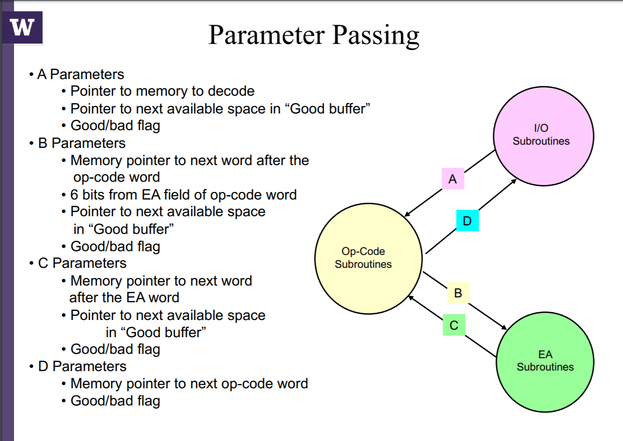

Slide 4
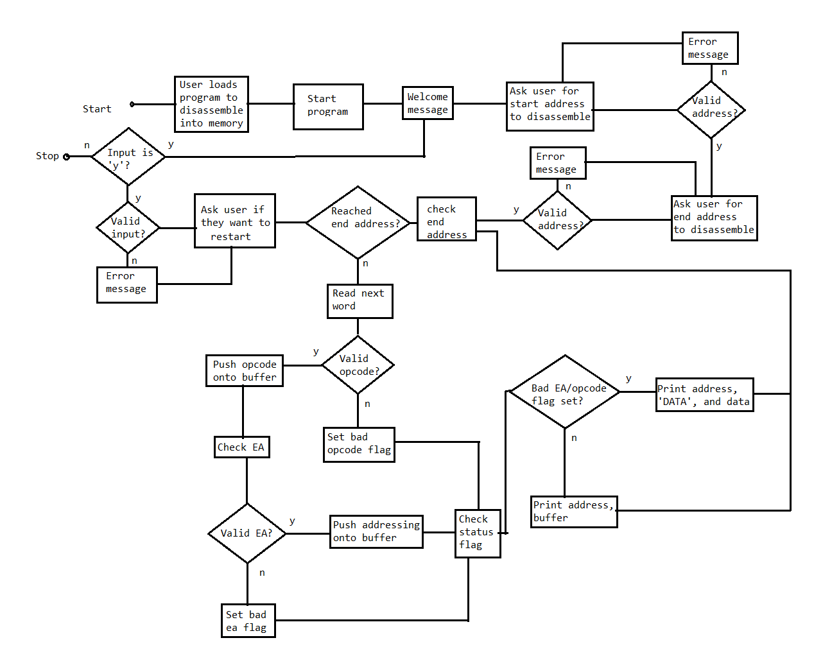
Flowchart

Slide 5
Loading a Program Into Memory
1. Make sure that the program you want to read has an origin that starts at an address after address $6000
2. Create an .S68 source file for your program
3. Go to file > open data, then open your .S68 source file
4. Run the disassembler
5. Enter the address of the program into the disassembler

Slide 6
Supported Opcodes/ EA
All 26 opcodes specified are supported. These are as follows:
NOP
MOVE
MOVEA
MOVEQ
MOVEM
ADD
ADDA
ADDI
ADDQ
SUB
MULS
All 8 EA specified are supported. These are as follows:
Dn - Data Register An - Address Register (An) - Address Register Indirect (An)+ - Address Reg. Indirect w/ post inc. -(An) - Address Reg. Indirect w/ pre decrement (xxx).W - Absolute short word (xxx).L - Absolute long word #<DATA> - Immediate Data
DIVU
LEA
CLR
AND
OR
LSL
LSR
ASR
ASL
ROL
ROR
CMP
Bcc (BCC, BGT, BLE)
JSR
RTS

Slide 7

Problems (all solved now!)
Getting started
Time management
Reading/writing to odd addresses in memory
Correct branching and returning from subroutines
Stitching code together
Testing

Slide 8

Cool things we learned
Subroutines for everything!
Helped loading into buffer (per byte, to avoid odd addressing problems)
Made EA tables efficient to enter
Two pointers!?
Needed a good pointer
And a moving pointer for opcode & EA person to move
Update pointers at the very end
Print later
Using a buffer to print instead of printing right after

Slide 9
Incomplete Tasks?
Make MOVEM param work
Handle odd addressing for memory
Bcc addresses incorrect
All good B)

Slide 10
Fin.

